Slide 1
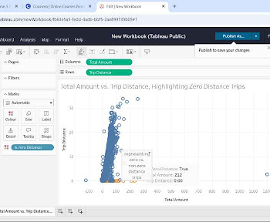
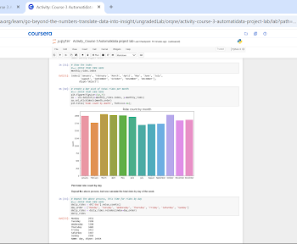
Title:Data Quality Issue: Zero-Distance Trips
Subtitle: Analysis and Impact
The primary issue uncovered during this Exploratory Data Analysis is the presence of a significant number of taxi trip records that show a Trip Distance of 0.0 miles, conflicting with the observation that many of these same trips registered a non-zero Total Amount charged to the passenger, indicating a notable data quality anomaly.
Initial data exploration flagged trips with zero recorded distance. To analyze this further, data visualization techniques were employed, specifically creating a scatter plot in Tableau [cite: image_58373e.jpg] that compared Total Amount and Trip Distance, using color to explicitly highlight the trips where distance was exactly 0.0 miles. This visualization confirmed the presence of these anomalies and allowed for observation of the corresponding (often non-zero) Total Amount associated with them.
Image Alt-Text Here
These trips recorded with zero distance but non-zero costs significantly impact data integrity and pose challenges for analysis and future modeling. Including these anomalous records could skew calculations of average trip metrics and negatively affect the performance and reliability of a fare prediction model, as it learns from inaccurate representations of the relationship between distance and cost. For the TLC, understanding the root cause is also important as it may highlight potential issues in data logging, indicate specific uncaptured operational events, or point to areas needing procedural review.
Image Alt-Text Here
The crucial insight derived from this specific analysis is the confirmation that a notable portion of trip records show zero distance traveled while still incurring a fare, directly highlighting this inconsistency as a significant data quality finding that warrants focused investigation by the TLC.

